Slide 1
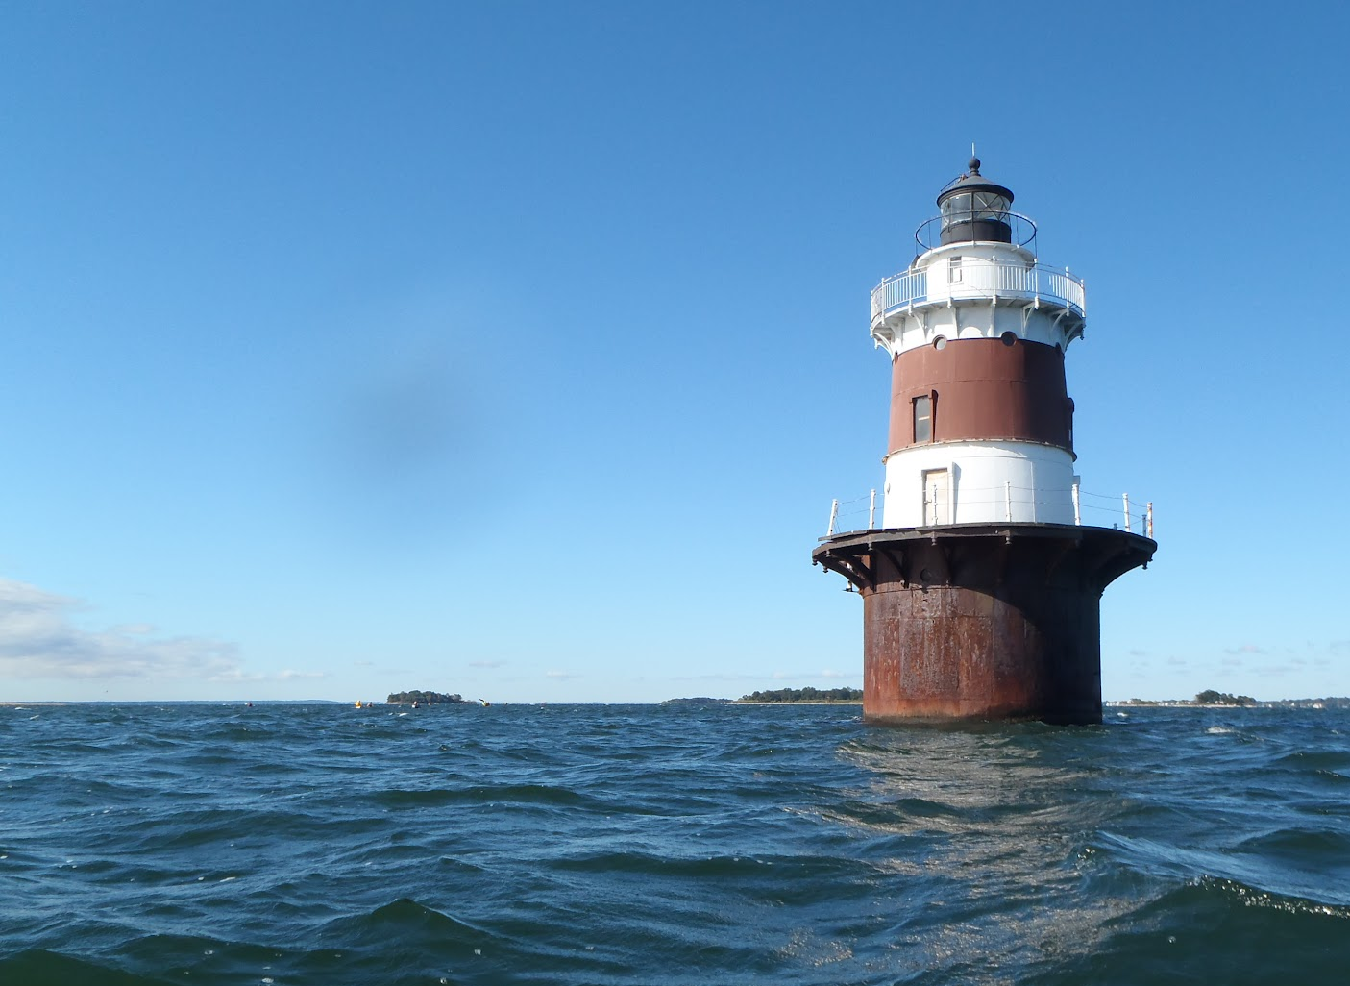
Welcome to the
2019 UWS Summit
Tracy Brown
Save the Sound
Peter H. Linderoth
Save the Sound, Western LIS Programs
Peter H. Linderoth
Water Quality Program Manager
https://www.flickr.com/

Slide 2
Meet the Embayments
Elena Colon, Save the Sound

Slide 3
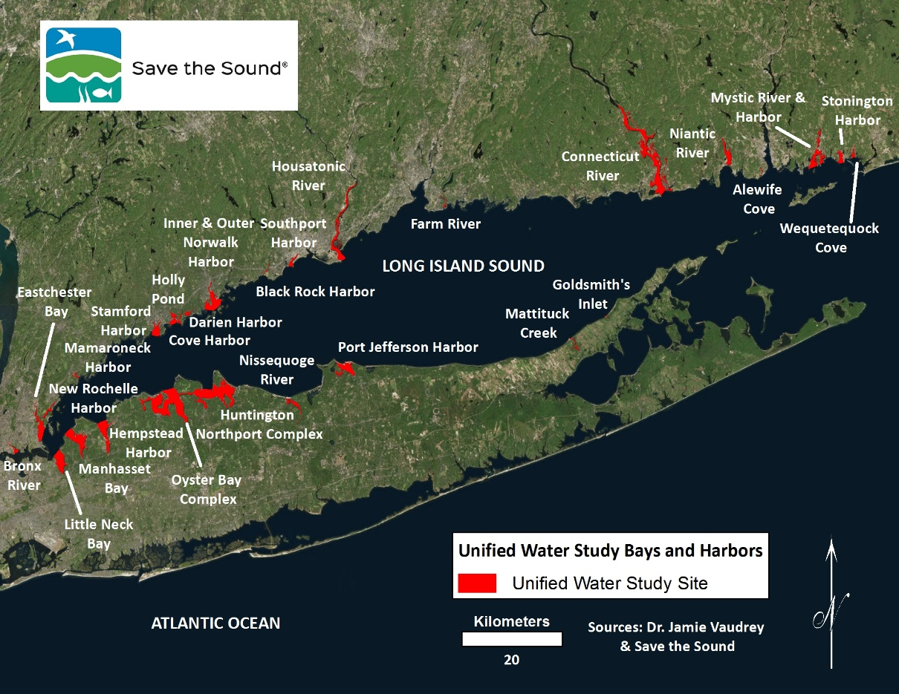
UWS 2019 Season: 36 Embayments

Slide 4
Clean Up Sound and Harbors (CUSH)

Slide 5
New England Science and Sailing (NESS)

Slide 6
Save the River, Save the Hills

Slide 7
CT River Conservancy & CT River Museum

Slide 8
Friends of the Farm River Estuary (FFRE)

Slide 9
Town of Stratford, Dept. of Conservation

Slide 10
Town of Fairfield, Dept. of Conservation

Slide 11
Ash Creek Conservation Association

Slide 12
Harbor Watch (Earthplace)

Slide 13
The Maritime Aquarium of Norwalk

Slide 14
Town of Darien

Slide 15
SoundWaters

Slide 16
Derecktor Shipyards

Slide 17
Save the Sound

Slide 18
Bronx River Alliance

Slide 19
Interstate Environmental Commission

Slide 20
Coalition to Save Hempstead Harbor (CSHH)

Slide 21
Friends of the Bay

Slide 22
Cornell Cooperative Extension of Suffolk County Marine Program

Slide 23
Salonga Wetlands Advocates Network (SWAN)

Slide 24
Setauket Harbor Task Force

Slide 25
Group for the East End

