Slide 1
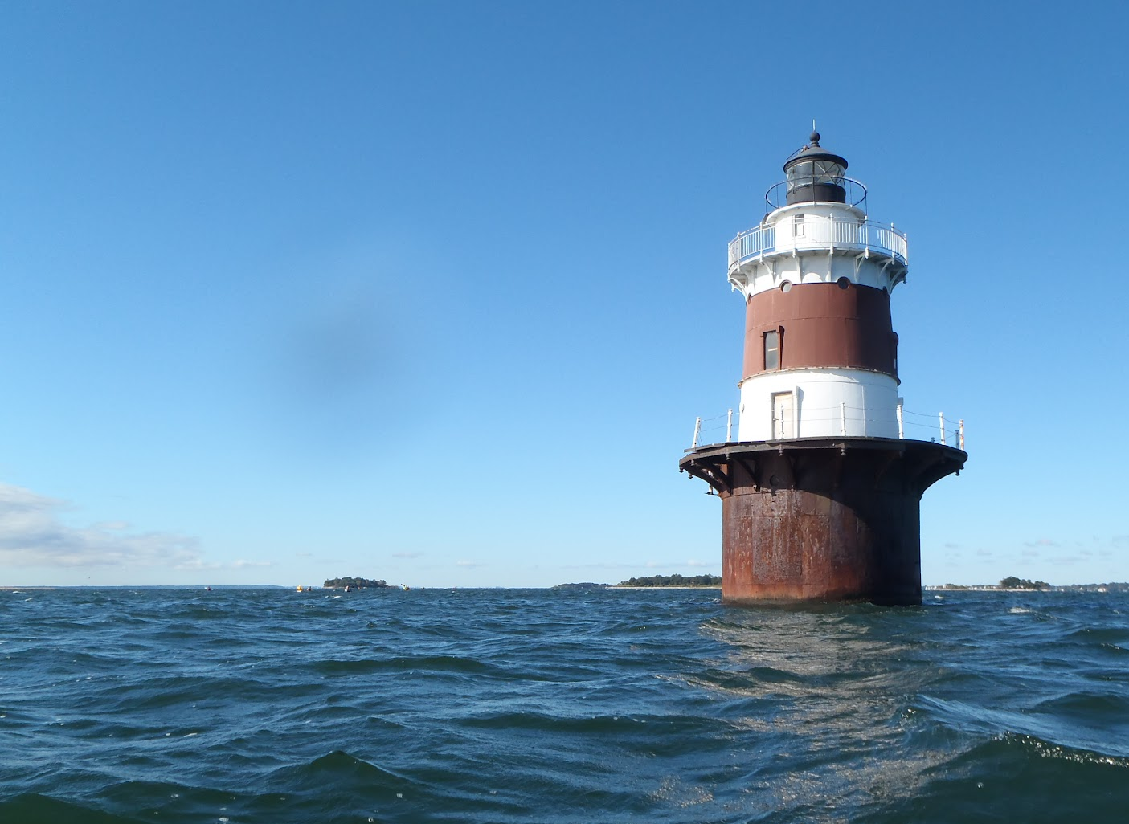

Unified Water Study
Technical Advisory Committee Meeting
Report Out
November 14, 2019
Dr. Jason Krumholz, UWS Science Advisor
Dr. Jamie Vaudrey, UWS Science Advisor
Peter Linderoth, Save the Sound

Slide 2
Deep vs. Shallow Water
N Load
N
N
N
N
N
N
O₂
O₂
O₂
O₂
O₂
N Load
CO₂+H₂0=Sugar+O₂
N
O₂
O₂
O₂
N
N
O₂

Slide 3
SHALLOW DEEP
Fully mixed
Light reaches to the bottom
Typically dominated by macroalgae (and/or eelgrass)
Oxygen levels have strong daily cycle driven by productivity and can experience supersaturation which is a eutrophication indicator.
Total Nutrient level in water column not well correlated with system productivity
Oxygen levels during the day not necessarily correlated with eutrophication
Seasonally/episodically stratified
Light does not reach bottom
Typically dominated by phytoplankton
Bottom water oxygen levels correlated with both productivity and stratification
Total Nutrient level in water column is a good indicator of system productivity
Bottom water oxygen levels are a good indicator of eutrophication

Slide 4




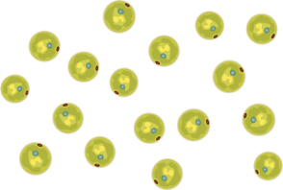
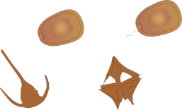




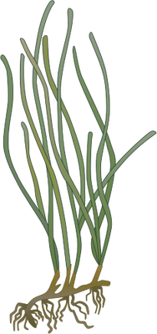
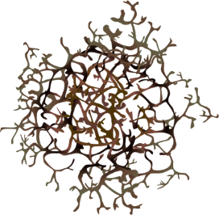







Sunlight + nutrients fuels primary productivity. Sunlight in shallow systems often reaches the bottom.
POORER WATER QUALITY
BETTER WATER QUALITY
Symbols courtesy of the Integration and Application Network, University of Maryland Center for Environmental Science (ian.umces.edu/symbols/).
Notes:
Jamie hands over to Jason.

Slide 5


UWS Parameters
Tier 1
Dissolved Oxygen
Turbidity
Chlorpophyll a
Qualitative Macrophytes
Temp. & Salinity
Tier 2
Continuous Dissolved Oxygen
Quantitative Macrophytes
Nutrients
6 Month Monitoring Season: May – October
Tier I WQ Twice a Month
Tier I Macrophytes 3 Times in Set Interval
Tier II Nutrients Twice a Month
Tier II Loggers checked every 7-10 Days
Tier II Macrophytes 1 day during set interval
https://landscapelightingguru.com/comparing-landscape-lighting-bids-apples-to-apples/

Slide 6
Pros and Cons
Literature Values:
  Relatively defensible values. Doesn’t pre-suppose A-F range among sampled systems
  Values not specific to system in question. Difficult to determine useful literature values for innovative techniques
Historical Data:
  Specific to system in question. Ideal in situations where “reference state” is clearly discernable
  Requires data rich system. Does not work with innovative metrics. Susceptible to “shifting baselines”
Existing Sampling Program:
  Specific to system and timeframe in question. Don’t have to deal with spatial/temporal mismatches
  Presumes range of values encountered spans range from “excellent” to “poor”. makes comparisons with other programs difficult
Biological Thresholds:
  Mitigates anthropocentric viewpoint. Tied to management objectives.
  Not always available. Biological reference points may not always align when multiple uses exist

Slide 7
Our Preliminary Thoughts
A hybrid approach blending data from our existing monitoring program, supplemented by biological reference points where feasible, and literature values as necessary.
Utilize WQ data from eelgrass supportive embayments in LIS as upper baseline (e.g. minimally supportive of eelgrass = A-).
Cross check worst scoring LIS embayments against literature values to establish grade for lowest scoring systems.
  Don’t want to automatically fail worst scoring embayments.
  Conversely, don’t want to give a marginally passing score if substantial improvement is needed to meet water quality objectives.
Initial grading metric focused on T1 only, T2 and some T1 data (e.g. macrophytes) used qualitatively in separate metrics.
Establish some sort of “Susceptibility Score” based on embayment size, residence time, and location in LIS to compare with grade and show which systems are doing well/poorly relative to LIS mainstem waters with which they exchange?

Slide 8
Oxygen Discussion
A
Oyxgen metric needs to reflect both hypoxia and supersaturation
Assigning a supersaturation “grade” won’t work because it will artificially improve the grade of reliably hypoxic systems that don’t supersaturate, and vice versa
A “bell shaped” grading profile makes the most sense in this situation
C
0mg/L
8mg/L
100%
150%

