Slide 1


Monitoring Season’s Over!
We want your data
How CT DEEP utilizes volunteer generated data for water quality assessments and implementation
Katie O’Brien-Clayton, Long Island Sound Water Quality Monitoring Program
Unified Waters Summit
Westport, CT
November 14, 2019

Slide 2

Environmental Protection Process
Monitor Water Quality
Evaluate Health of Connecticut's Waters
Develop Actions Plans to Protect or Restore
Work with Partners
Implement Actions
Over 6,000 miles of rivers and streams
425 major lakes and ponds
82 coastal harbors and bays
Long Island Sound Proper
DEEP staff of just 8 full time employees
How can we assess everything?
Notes:
Under federal law, states across the US are required to monitor and report on the status of their surface water quality every 2 years. The summary report of these assessments is known as the Integrated Water Quality Report. In CT we have over 6,000 miles of rivers and streams, … with just a staff of 8 to monitor both freshwater and estuarine resources.

Slide 3
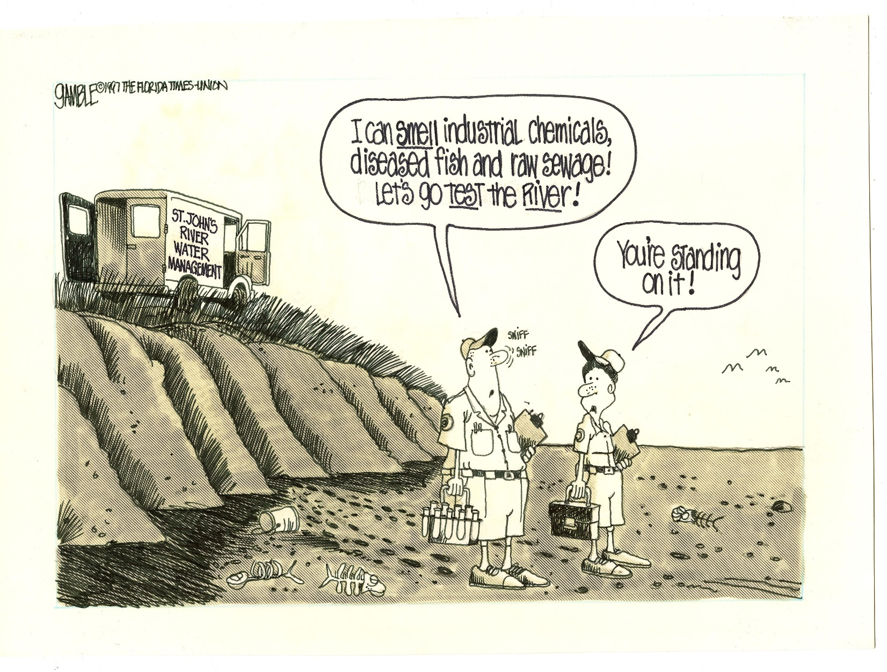
This is where volunteer water monitors come in
Notes:
Thank you all for stepping up to go out and test the waters of the state of CT as part of the UWS.
You all got up at 4 AM and were out on the water before the sun came up gathering pre-dawn DO data.
Not just Peter, Jamie, and Sarah being sticklers…. Reason behind all the trainings, SOPs, and QAPPs they made you do

Slide 4
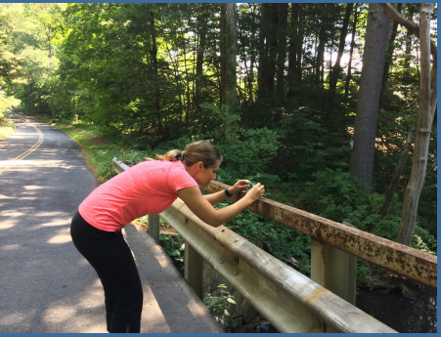
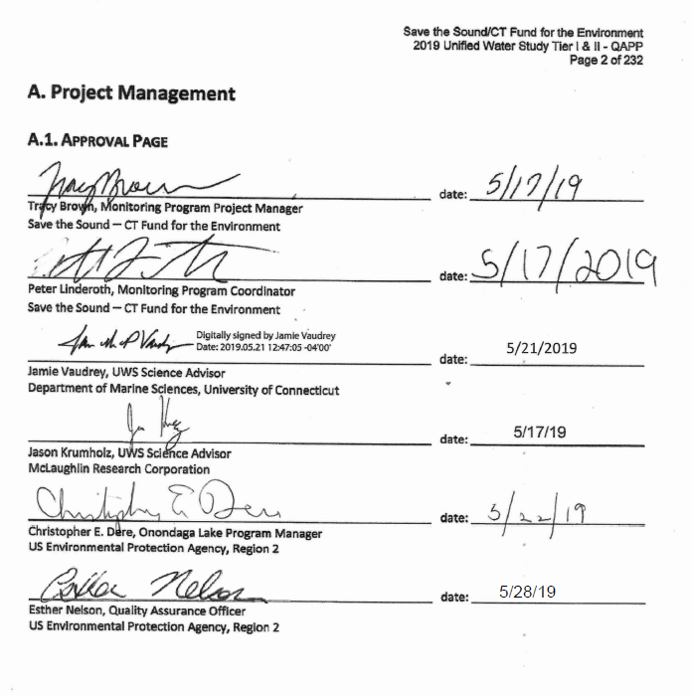
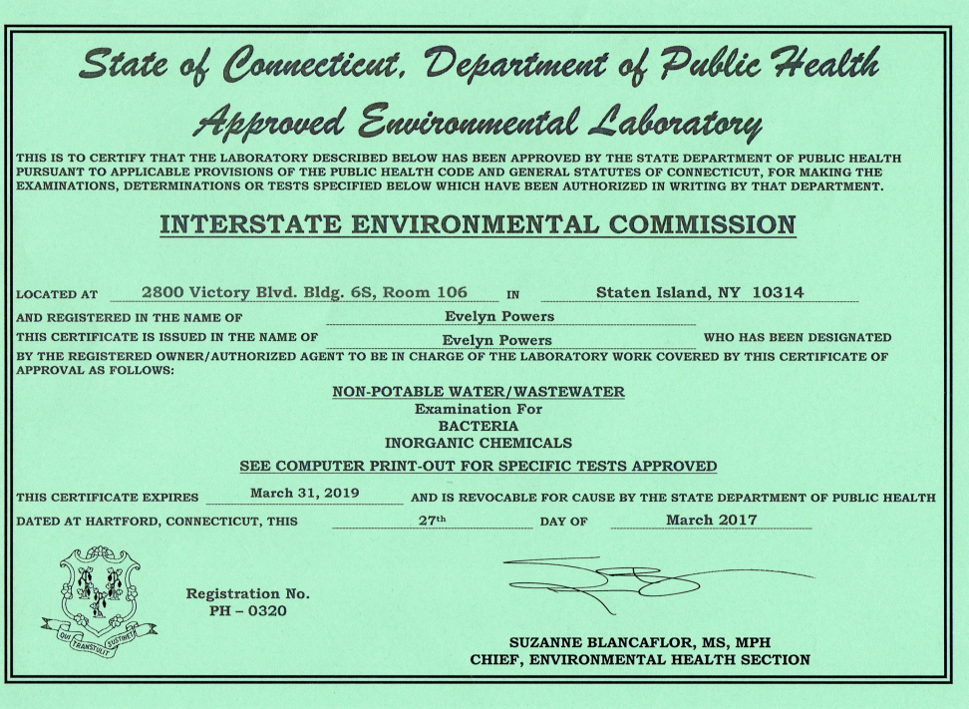
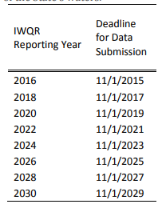
3 Tiers of Data
Tier 1- Digital photos or written observations
(not sufficient for assessment alone)
Tier 2- Data not collected under a formal QAPP
(not sufficient for assessment)
Tier 3-
Data collected under an EPA or DEEP Approved QAPP with SOPs
(may be suitable for assessment, reviewed by DEEP on case by case basis)
Samples analyzed at a State Certified Lab
Data presented in a Citable “Report”
Raw QA/QC’d Data Submitted to DEEP by Nov. 1 in odd years
UWS DATA= Tier 3
Notes:
Discuss minimum requirements for data submissions for consideration
UWS data fall under Tier 3.
UWS system makes it a bit easier for me as I only have to review 1 QAPP and 1 set of SOPs.
Data submitted is formatted easily and I can reference the UWS website
Deadlines for data submissions is Nov 1 of odd years

Slide 5

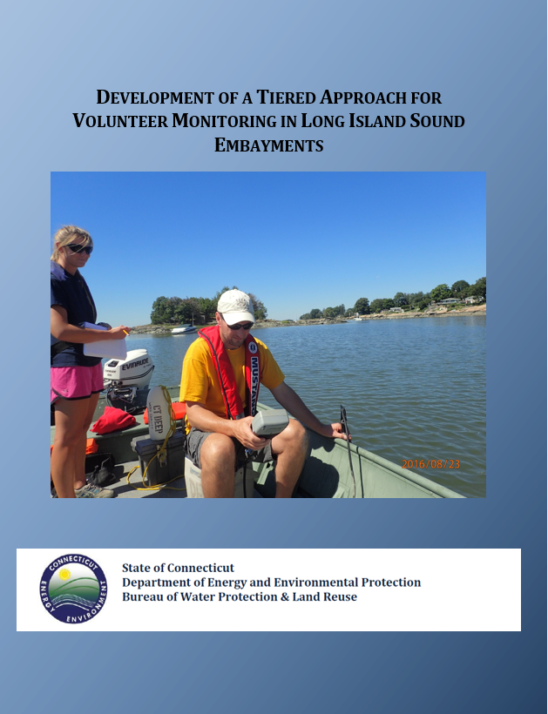
Guidance Documents
Notes:
DEEP has prepared guidance documents

Slide 6
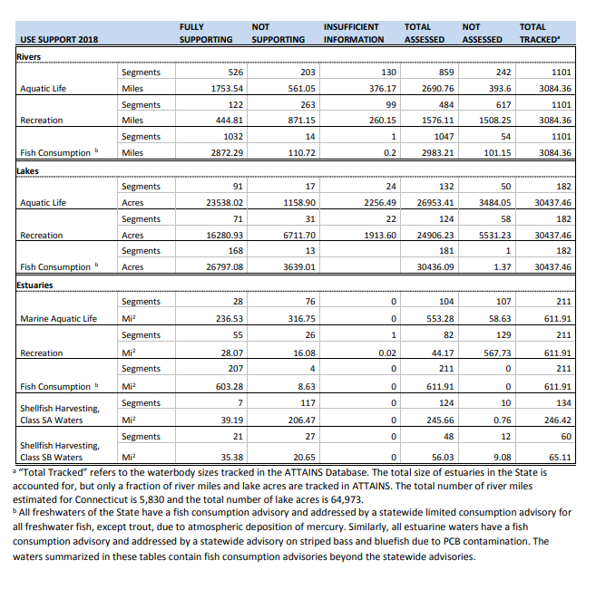
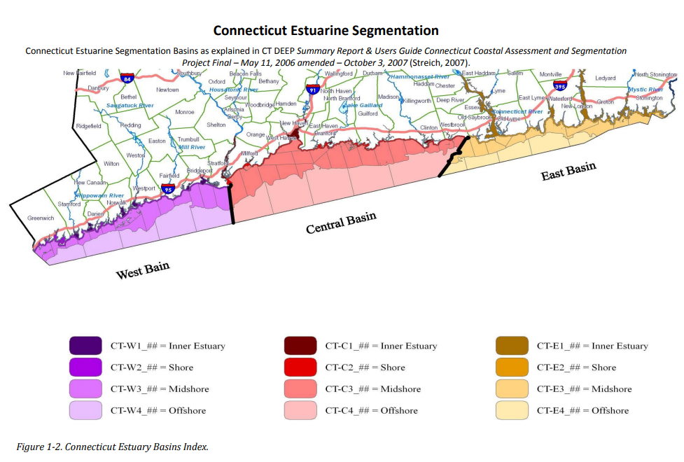
Segmentation
Notes:
Currently CT has 211 estuarine assessment units or segments
Broken up into zones-
Assessed for four designated uses

Slide 7
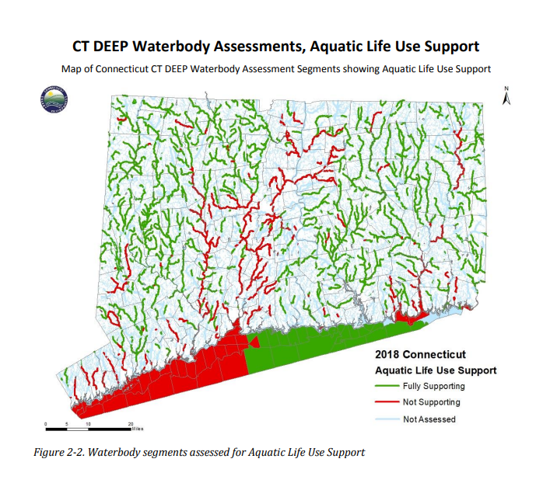
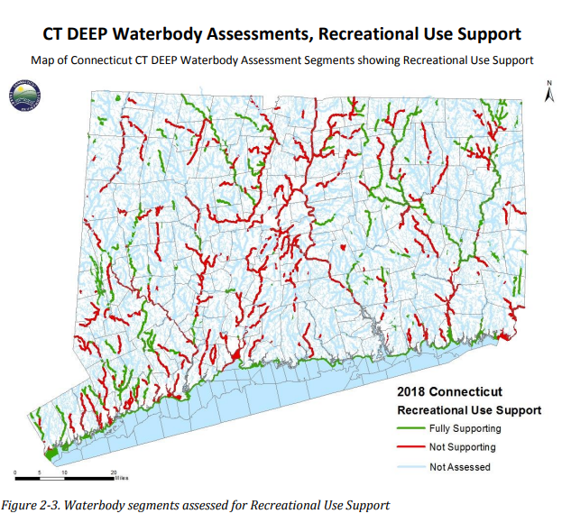
Designated Use Assessments
Notes:
ALUS- 107 segments not assessed
Of the 104 that are, most are offshore segments based on DEEP LIS Cruise data and LISICOS buoy data
Rely heavily on early morning DO data
REC- offshore segments not assessed as our program does not collect bacteria samples
Nearshore based on beach closure info and indicator bacteria data collected by volunteers
Also macroalgae data intensive quantitative surveys

Slide 8
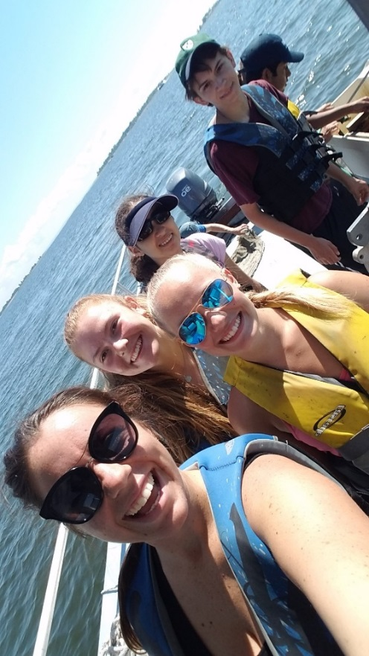
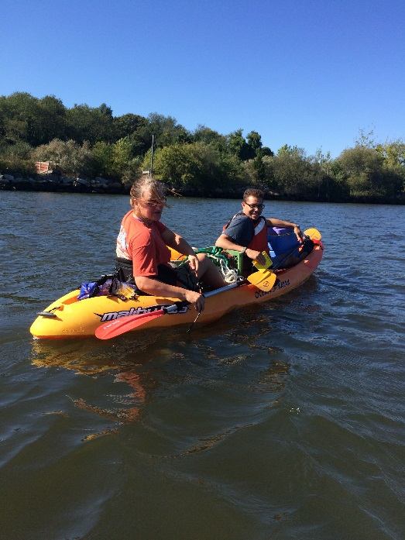
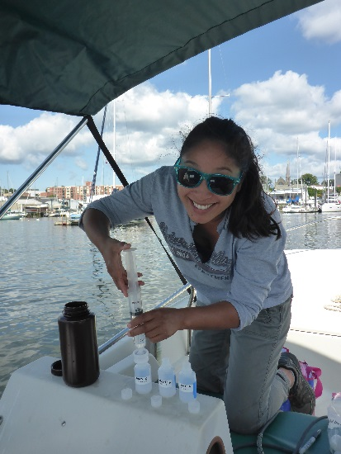
Volunteer Contributions
2016 and 2018 Integrated Water Quality Report
Data from CUSH, Save the Bay Westerly, Harbor Watch, STS
ALUS
7 segments based on CUSH data
2 segments based on Save the Bay
6 segments based on Harbor Watch
REC
5 segments based on STS bacteria
only stations
7 more from CUSH
2 from Save the Bay
6 Harbor Watch
Notes:
Remember- UWS data not available for 2016 or 2018 assessment report

Slide 9
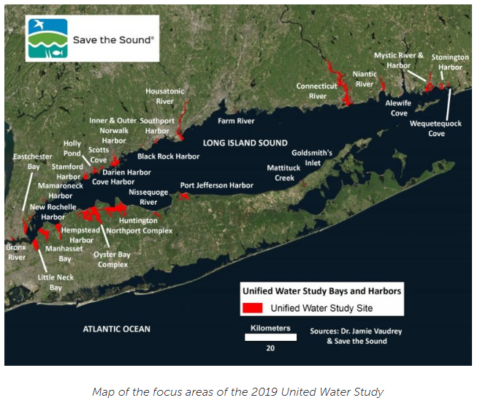
Volunteer Contributions
2020
ALUS
Potential 20 segments using 2018 UWS data
+ 7 more from CUSH non UWS stations
+ 2 from Save the Bay
+ 6 Harbor Watch non UWS stations
REC
5 segments based on STS bacteria only stations
+ 7 more from CUSH
+ 2 from Save the Bay
+ 6 Harbor Watch non UWS stations
Notes:
Tier 1 data
2019 data will be utilized for 2022 report.
Continuous DO data will be very helpful

Slide 10
Environmental Protection Process
  Integrated Water Resource Management
  Develop plans that lead to water quality restoration and protection
  Build on & expand internal & external partnerships
Monitor Water Quality
Evaluate Health of Connecticut's Waters
Develop Actions Plans to Protect or Restore
Work with Partners
Implement Actions
Notes:
Assessments are complete, waters are impaired, now what?
TMDL comes in. Traditionally been tasked with preparing a TMDL or total maximum daily load- in essence a pollution diet for impaired segments.
In 2016 DEEP began new process to develop plans to address impairments, but also to protect areas with good water quality. The new process, called IWRM, is heavily dependent on internal and external partnerships.

Slide 11
303d Integrated Water Resource Management
A renewed approach to focusing existing programs to achieve Water Quality goals
Works within existing regulatory frameworks – No new regulatory requirements
Collaboration Between EPA & States Starting 2011
WQ Action Plans
CT-Specific WQ Concerns
Communicate
Information on CT Watersheds
Restore & Protect
Collaborate
Use the right tool for the job
Achieve Water Quality Protection & Restoration Goals
Notes:
New process works within the existing regulatory structure

Slide 12
Water
Quality Restoration & Protection
IWRM Water Quality Priorities
Nutrients
Healthy Waters for Health Fish & Wildlife
Stormwater
Coastal Embayments
Swimming & Shellfishing
Water Quality Priorities
  Continue work on bacteria impairments and storm water
  Expand focus to include :
    nutrients, coastal areas & aquatic life/wildlife support
    Water Quality Restoration & Protection
Notes:
The Initial Process prioritizes watersheds with focuses on bacteria impairments as well as nutrients and aquatic life support.

Slide 13
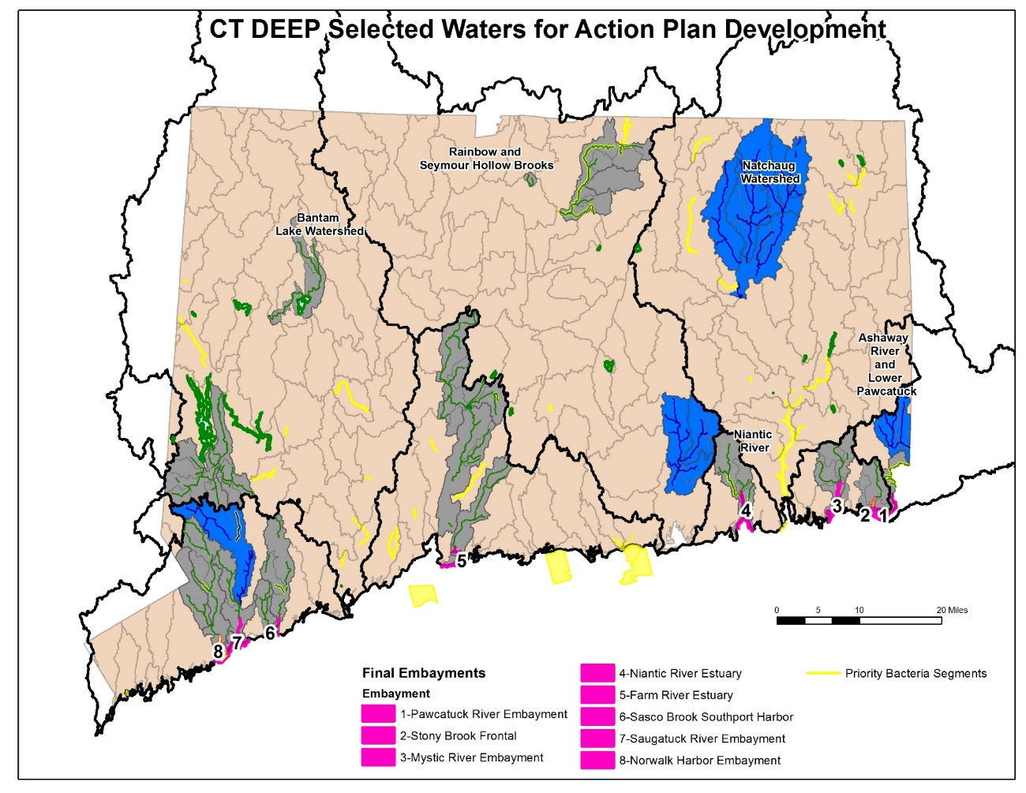
IWRM Updates 2016 Based on Public Comment
Locations for Initial Water Quality Restoration and Protection Plans
Developed using EPA Recovery Potential Screening Tool modified with CT-specific information
Active projects and partnerships
Public Feedback
Notes:
The initial process in 2016 selected 8 embayments as priority areas based on a tool called the Recovery Potential Tool, public feedback, and watersheds with active partners that we could engage.

Slide 14
Overview: Watershed Based Approach to Nutrients
Estuaries and Associated Freshwater Watersheds
Build on existing WQ restoration activities
  Bacteria TMDLs
  WQ Based Permits
  EPA Nitrogen Reduction Strategy
  CT Second Generation Nitrogen Strategy
  Habitat improvements
Upland Watershed Model
Downstream Watershed Model
Hydrologic Simulation Program Fortran (HSPF)
Tiered Approach to Model Selection
Data from Unified Water Study projects can be used to characterize water quality and provide data for modeling within coastal embayments identified for plan development under Integrate Water Resource Management
Notes:
TMDL staff traditionally use modeling to determine load allocations for the pollution diets. Through IWRM, we plan to update two models. The models will need water quality data for calibration and validation. UWS data can be used in the models.

Slide 15
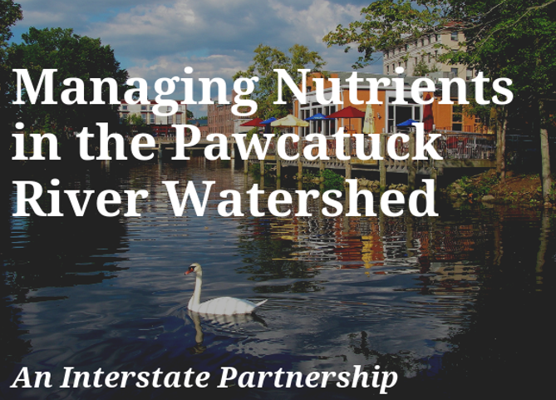
Pawcatuck River Watershed Project
Pawcatuck River Watershed and Estuary was selected for development of initial coastal estuary plan
Project web page
  Updates
  Reports
  Data
Interactive Story Map
Meetings with Partners and Stakeholders to be planned
Click on the picture above to go to the Pawcatuck Project Story Map
http://www.ct.gov/deep/pawcatucknutrientstudy
Notes:
Pawcatuck is our first watershed for development of a restoration plan. In conjunction with RI. Developed a webpage and interactive story map.

Slide 16
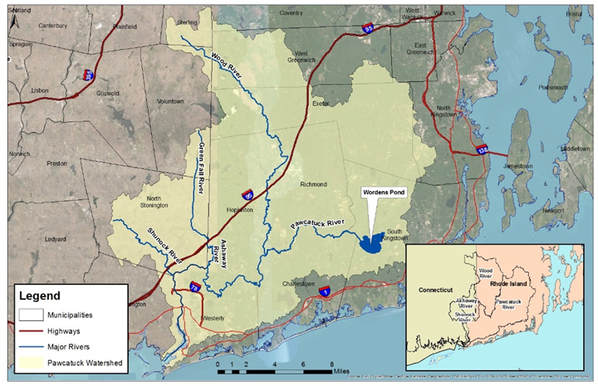

Partnering for the Pawcatuck
Project Partners:
CTDEEP,
Rhode Island Dept of Environmental Management
Save the Bay
Project Supported by a Southeast New England Program (SNEP) Watershed Grant, which is funded by EPA through collaboration with Restore America’s Estuaries https://estuaries.org/

Slide 17
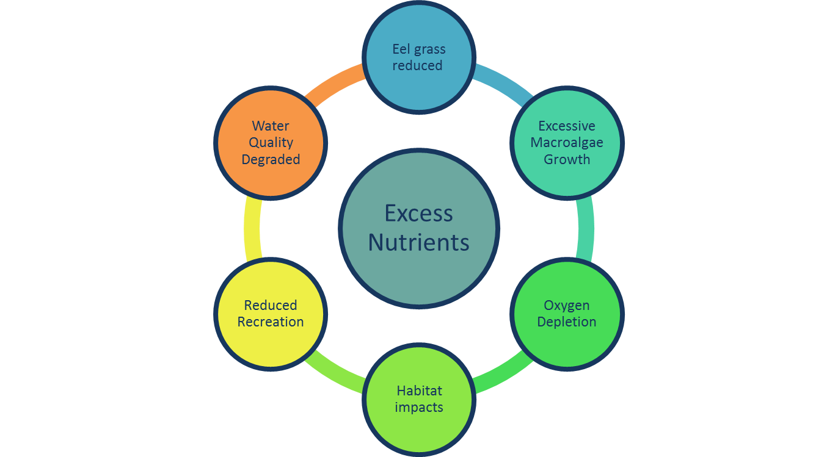
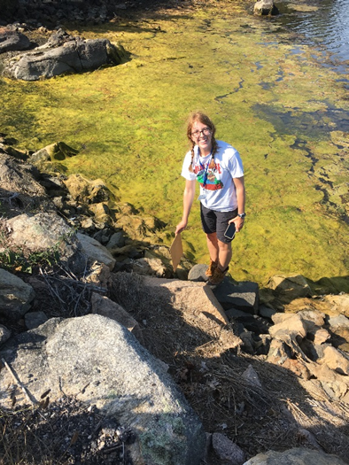
Pawcatuck River Watershed & Estuary
Pawcatuck River Estuary
WQ Impairments from bacteria & insufficient oxygen
USGS study nutrients decreased 1975-2015
Other studies
  Disappearance of eelgrass
  Extensive growth Cladophora spp.
  Mucky, oxygen poor sediments
Highest total load of nitrogen per embayment area in Long Island Sound (Vaudrey et al, 2016)

Slide 18
Pawcatuck Watershed: Estuary Work
Sampling
2018
  Sampling in Pawcatuck River Estuary by RIDEM & USGS (CT)
2019
  Sampling in Pawcatuck River Estuary and Little Narragansett Bay by RIDEM and USEPA
  Macroalgal sampling by Dr. Vaudrey using Unified Water Study Procedures
  Reach out to other sampling efforts
Modeling
Consulting with EPA Narragansett Lab
Notes:
Funded under SNEP grant awarded jointly to RI and CT

Slide 19
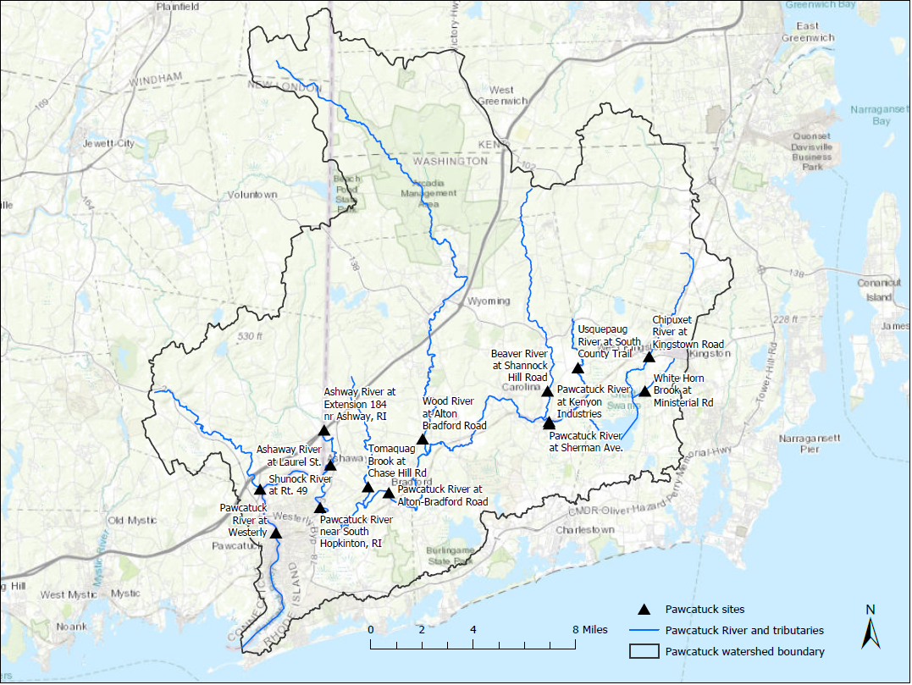
SNEP Project Components- FW portion of watershed
Water Quality Monitoring
Monitoring by USGS
Nitrogen, phosphorus, flow, solids, dissolved oxygen, chlorophyll a, general chemistry
Samples collected monthly November – March and bi-weekly April – October
Objective: Generate WQ data in upland watershed that characterizes a range of flow conditions, weather and seasons

Slide 20
SNEP Project Components
HSPF Watershed Model
  Hydrologic Simulation Program - Fortran
  Comprehensive
  Hydrology & WQ
  Addresses soil, groundwater, surface water processes
  Storm Events
  Point & Non-point Sources
  Used previously in CT, RI & other states
  Developed for Fresh water portion of watershed
  Supported by EPA and USGS
Objective: Create a tool to evaluate and predict and evaluate watershed responses based on current and future conditions

Slide 21
Extending to Other CT Embayments
Support from LISS to develop HSPF Model for rest of CT
Pawcatuck Project is demonstration project for this concept
Working with USGS to develop associated monitoring program
Expect to contract for statewide HSPF model update
Considering a tiered approach to embayment modeling
Focus on initial embayments identified in IWRM
Coordination with other LIS efforts
Notes:
Need for data and samplers- Farm River, Niantic, Saugatuck, Norwalk

Slide 22
Contact Information
305b Water Quality Assessments or LIS WQMP
Integrated Water Resource Mgmt
Traci Iott
Supervising Environmental Analyst
Total Maximum Daily Loads, Water Quality Standards Program
860-424-3082
Traci.iott@ct.gov
www.ct.gov/deep/iwrm
Katie O'Brien-Clayton
Environmental Analyst 2
Long Island Sound Water Quality Monitoring Program
860-424-3176
katie.obrien-clayton@ct.gov
www.ct.gov/deep/liswaterquality
www.ct.gov/deep/iwqr

Slide 23
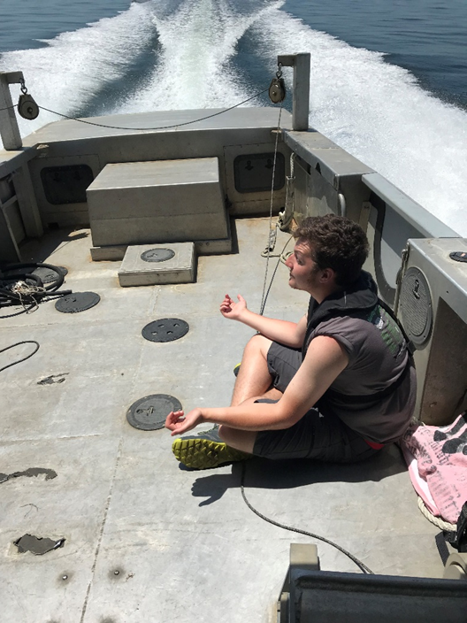
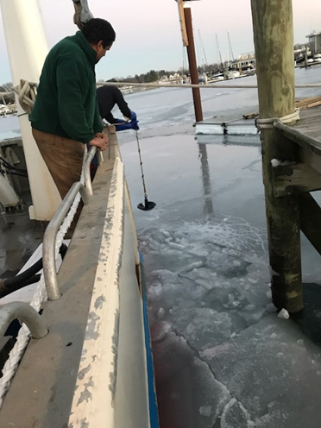
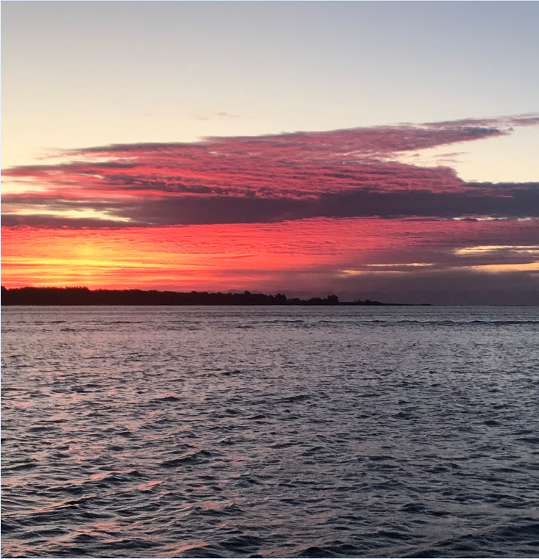
Questions?

