Slide 1
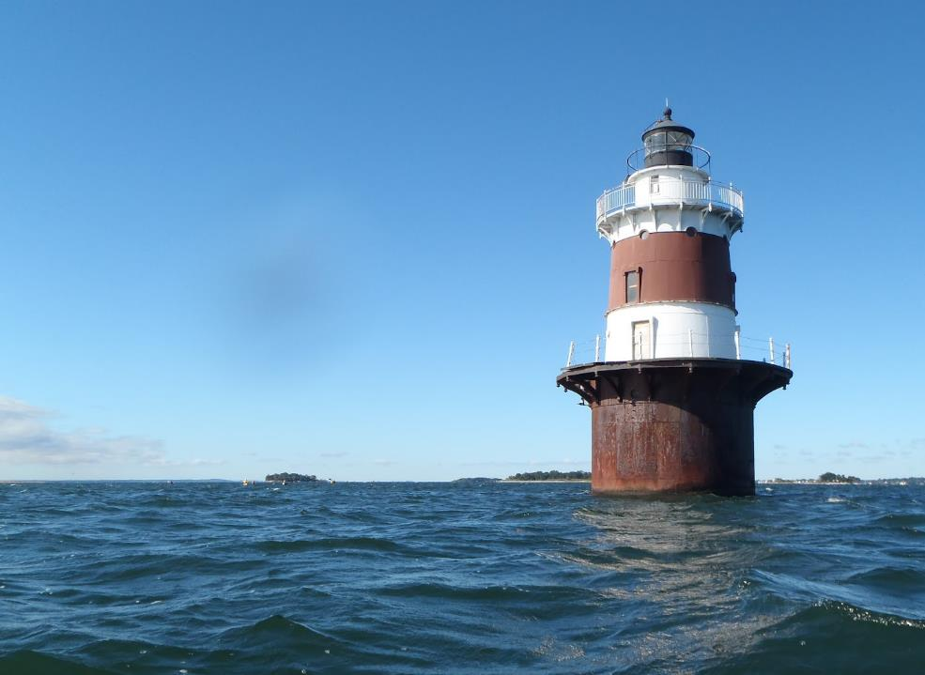

Unified Water Study
Monitoring Update
Peter Linderoth
Save the Sound
Peter H. Linderoth
Save the Sound, Western LIS Programs
Peter H. Linderoth
Water Quality Program Manager
https://www.flickr.com/

Slide 2

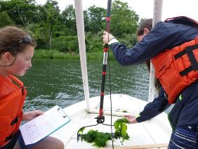
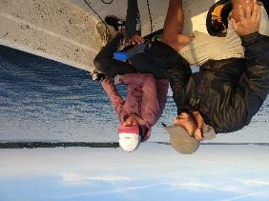
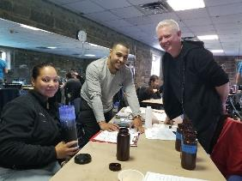
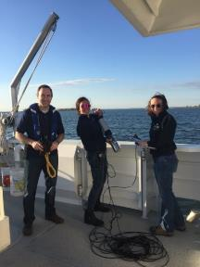
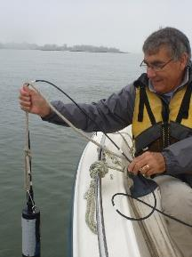
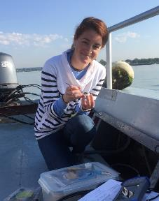
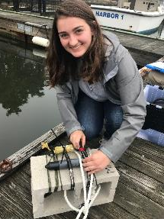
Congratulations & Thank You!

Slide 3
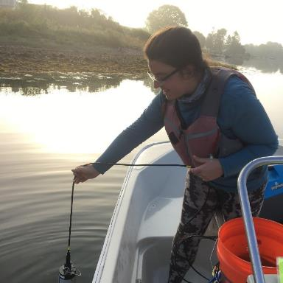
Discussion Overview
Unified Water Study (UWS)
Current Status
Future Plans
Next Steps
Questions/Comments

Slide 4
UWS Current Status and Future
Possible inclusion of 2 new Tier I Groups and Tier II Rotations
20 Monitoring Groups
36 Tier I Embayments
Tier I Study piloted by 3 groups
2015
2017
2019
2016
2018
2020
STS Coordinates UWS after Agreement made to Release LIS Report Card
Tier I Study Officially Launches:
11 Monitoring Groups 21 Embayments
22 Monitoring Groups
39 Tier I Embayments w/13 Receiving Tier II
Save the Sound Pilots Tier II & Harbor Watch Launches Equipment Loan Program (ELP)
ELP Torch passed from Harbor Watch to Save the Sound

Slide 5

UWS Current Status: Parameters
Tier 1
Dissolved Oxygen
Turbidity
Chlorpophyll a
Qualitative Macrophytes
Temp. & Salinity
Tier 2
Continuous Dissolved Oxygen
Quantitative Macrophytes
Nutrients
6 Month Monitoring Season: May - October
https://landscapelightingguru.com/comparing-landscape-lighting-bids-apples-to-apples/
Notes:
UWS Parameters and Season. Apples to apples comparison of embayments through standardized study approach

Slide 6

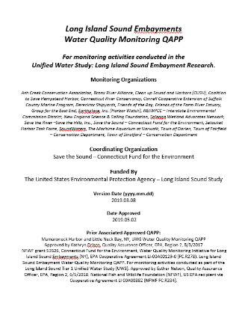

UWS Current Status: QAPP
UWS Tier I & II Quality Assurance Project Plan (QAPP)
Participating Groups included in EPA-Approved QAPP

Slide 7
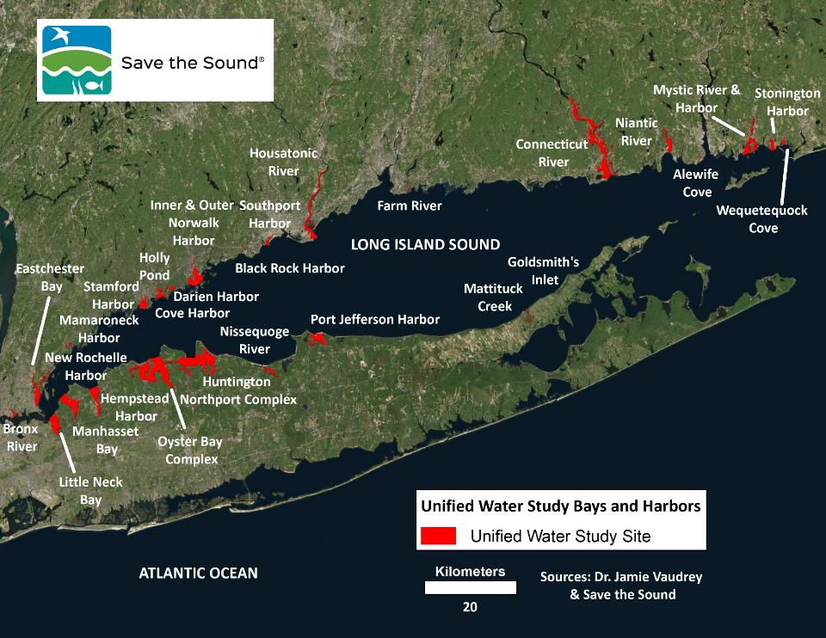
Notes:
Where is UWS happening now? And which groups?

Slide 8
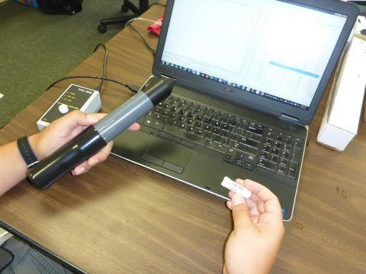
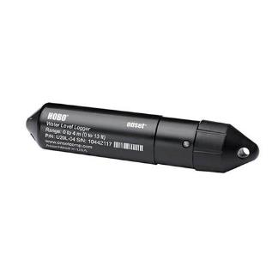
UWS Current Status: Tier II Dissolved Oxygen
Sampling instruments:
Onset HOBO DO logger
Star-Oddi Salinity Logger
Onset HOBO Barometric Pressure Logger

Slide 9
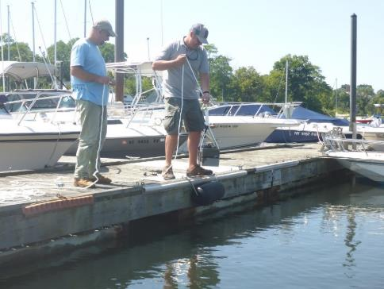
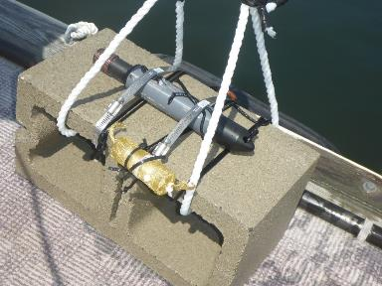
UWS Current Status: Tier II Dissolved Oxygen
DO Concentration, Absolute Pressure, and Salinity at 15 minute intervals
Sonde-loggers Intercomparisons
Station Visits are Required every 10 days for Cleaning and Comparison with Sonde
Minimum of One Station per Region

Slide 10
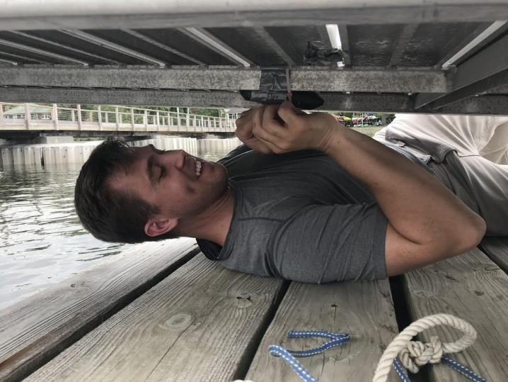
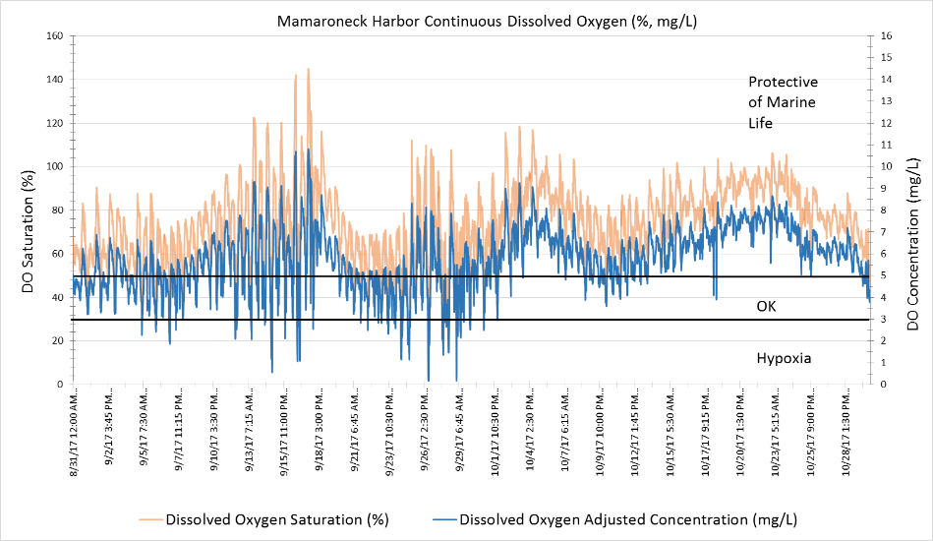
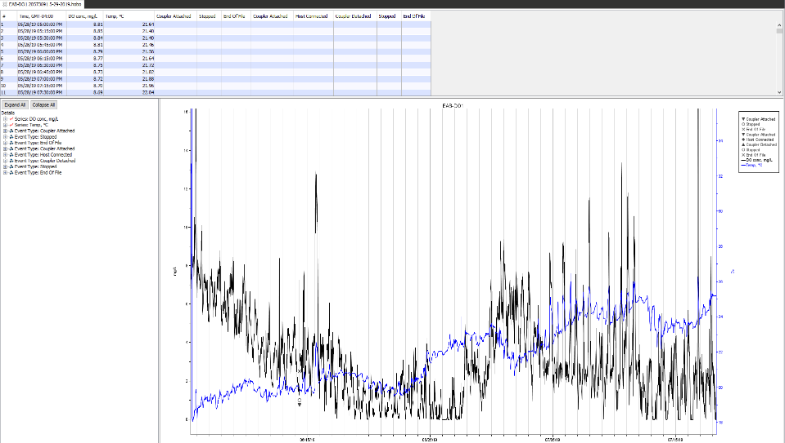
UWS Current Status: Tier II Dissolved Oxygen

Slide 11
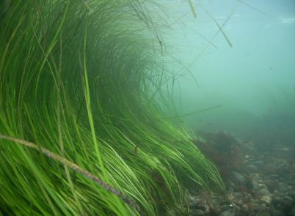
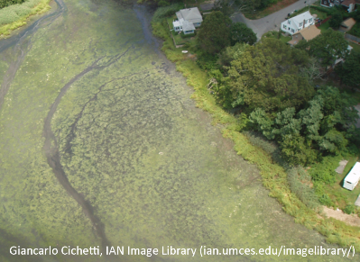
UWS Current Status: Tier II Quantitative Macrophytes
Sampling Occurs Once per Embayment during a 3-week Period between July 15 - August 7
http://www.habitat.noaa.gov/abouthabitat/eelgrass.html

Slide 12

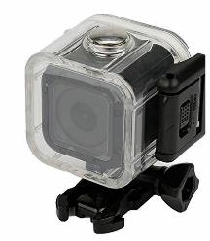
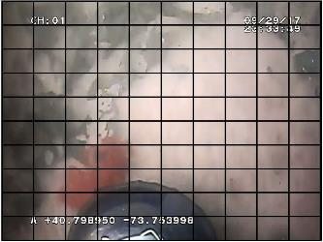
UWS Current Status: Tier II Quantitative Macrophytes
Percent Coverage of Macrophytes and Determine Bottom Type
Underwater Camera is used to Capture Images of the Bottom in the Area of a WQ and Rake Toss Stations

Slide 13
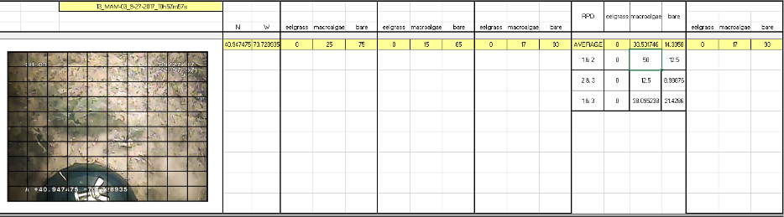
UWS Current Status: Tier II Quantitative Macrophytes

Slide 14
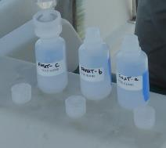
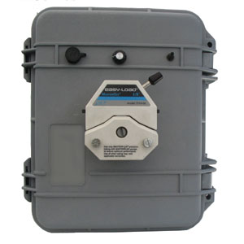
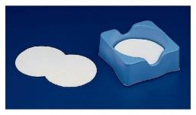
Tier II - Nutrients
Tier II Nutrient Stations are a subset of the Tier I Water Quality stations
Sampling Frequency: Every 2 weeks
Samples collected 0.5 m below the surface
Total Nitrogen
Nitrate & Nitrite
Ammonia
Total Phosphorous
Orthophosphate
Notes:
Maybe not

Slide 15
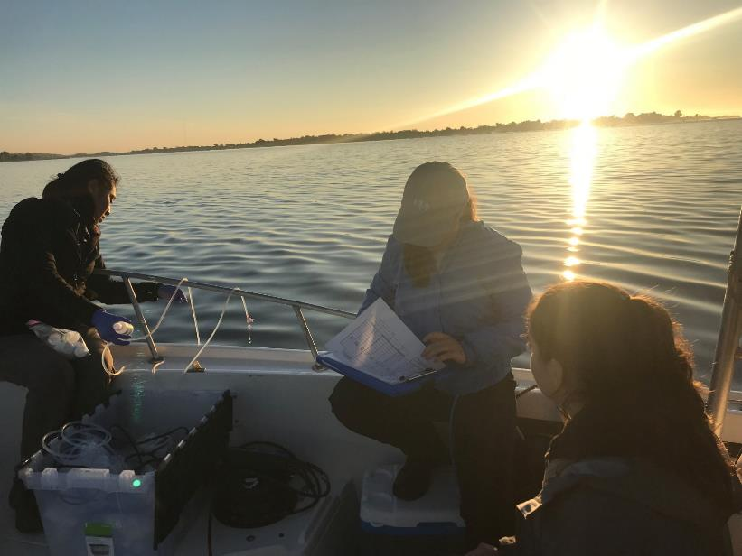
Tier II - Nutrients
Notes:
Maybe not

Slide 16
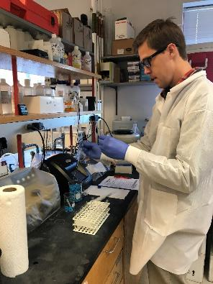
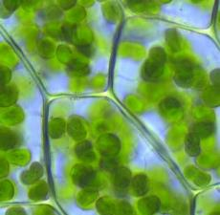
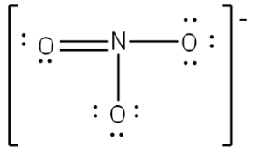
UWS Current Status: Project Laboratory
UWS Tier I & II Lab Analyses
Project Laboratory: Interstate Environmental Commission
- Strengthened Data Comparisons
- Lowers Study Expenses
- ELAP Certified
https://www.shodor.org/UNChem/basic/lewis/index.html
https://www.lovethegarden.com/community/fun-facts/plant-cells-how-plants-grow

Slide 17
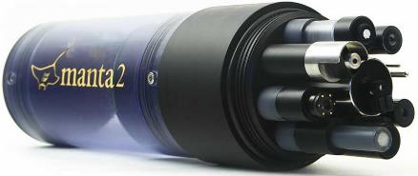
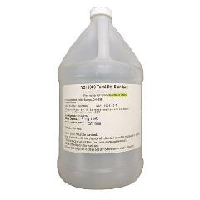
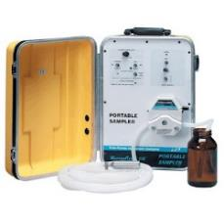
UWS Current Status: ELP
UWS Equipment Loan Program (ELP)
Sensor/Cable Assessments and
Replacements
Pump Retrofits/Replacements
Software Updates
Long-Term Storage
2020 Preparation; Believe it!
http://www.geoscientific.com/dataloggers/manta2-sensors.jpg
https://www.masterflex.com/i/masterflex-e-s-portable-sampler-115-vac/0757100
https://www.ysi.com/ProductImages//2318b652-7e2e-4cce-ac52-5d7a7913cdd8/images/YSI-6080-Turbidity-Standard-600x600(2).jpg

Slide 18

UWS Future Plans
Funding is in Place for 2020 season
Thank you, EPA LISS
Working on 2021 Funding Submission
https://science.sciencemag.org/content/344/6179/24
Notes:
Maybe not

Slide 19

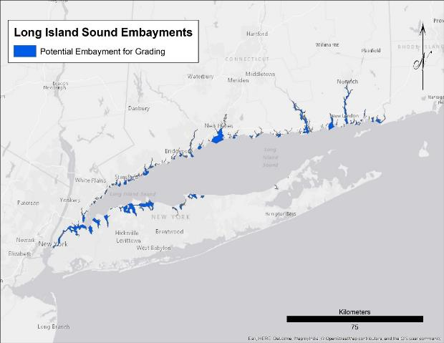
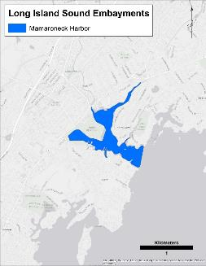
UWS Future Plans
Rotating Tier II Monitoring while Expanding # of Tier I Embayments
Embayment Grades in Long Island Sound Report Card
Notes:
Expansion to New Haven Harbor and Flushing Creek/Bay. T II rotating around Sound

Slide 20
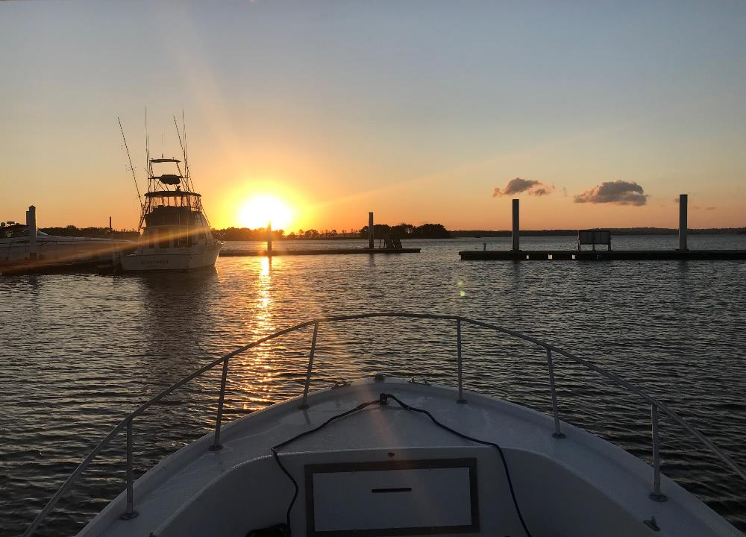
Thank you! Questions/Comments?
plinderoth@savethesound.org
(914) 263-6233

Slide 21
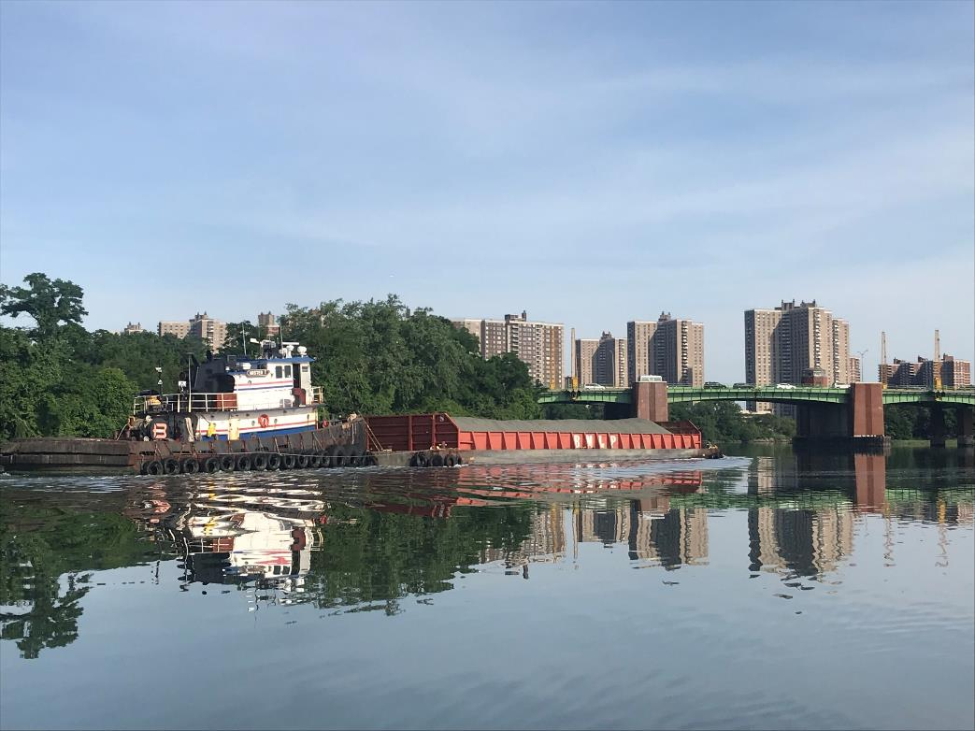
Unified Water Study
Data Usage & Scoring Update
Peter Linderoth, Save the Sound
Mark Tedesco, EPA LISS
Katie O'Brien-Clayton, CTDEEP
Jason Krumholz, UWS Science Advisor
Sue Van Patten, NYSDEC
Peter H. Linderoth
Save the Sound, Western LIS Programs
Peter H. Linderoth
Water Quality Program Manager

Slide 22
Discussion Overview
UWS Data Usage
Aggregation and Dissemination
EPA Water Quality Portal & Management Plans
CTDEEP IWQR & IWRM
NYSDEC LINAP
UWS Technical Advisory Committee
Questions/Comments
Notes:
Maybe not

Slide 23
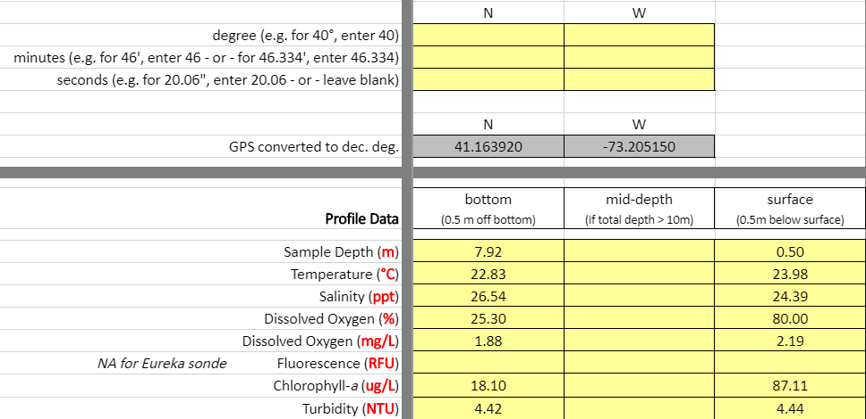
UWS Data Usage: Aggregation & Dissemination
UWS Data Entered into Project Template
Consistent Final Formatting
Quality Assurance Checks
Template Holds Abundant, and Critical, Metadata
Facilitates Wide-Spread Data Sharing

Slide 24




UWS: Putting Data Into Action Summary
Support EPA Nitrogen Strategy, NYSDEC LINAP, CTDEEP IWQR and IWRM
Inclusion in a “Roadmap” to Prioritize Restoration and Protection Actions
2020 UWS Site Grades to Inform and Engage the Public
Notes:
Over 100
LIS embayments
All groups encouraged to participate

Slide 25
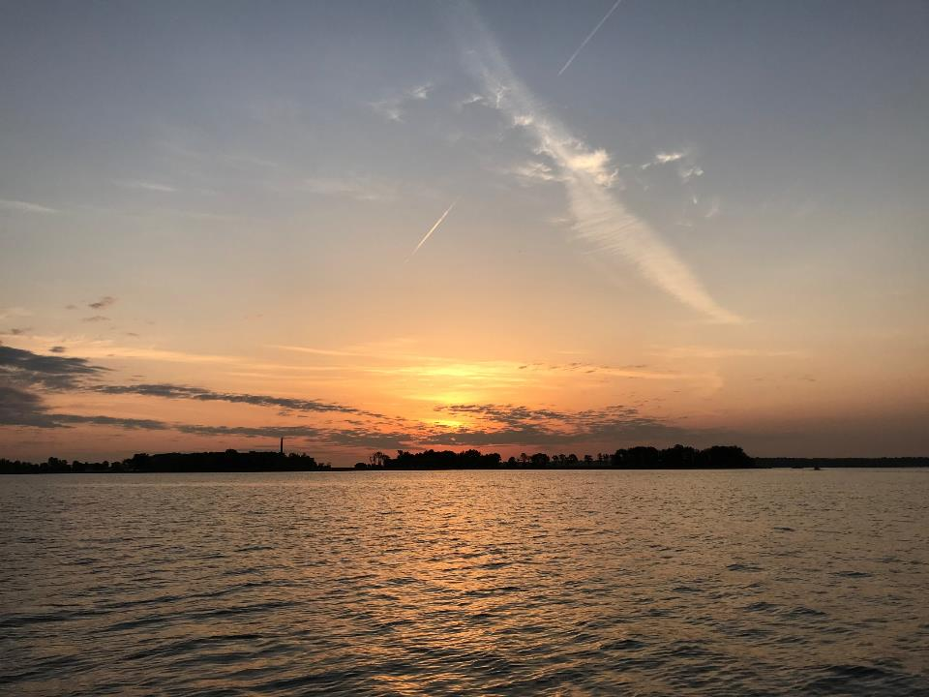
Thank you! Questions/Comments?

