Slide 1
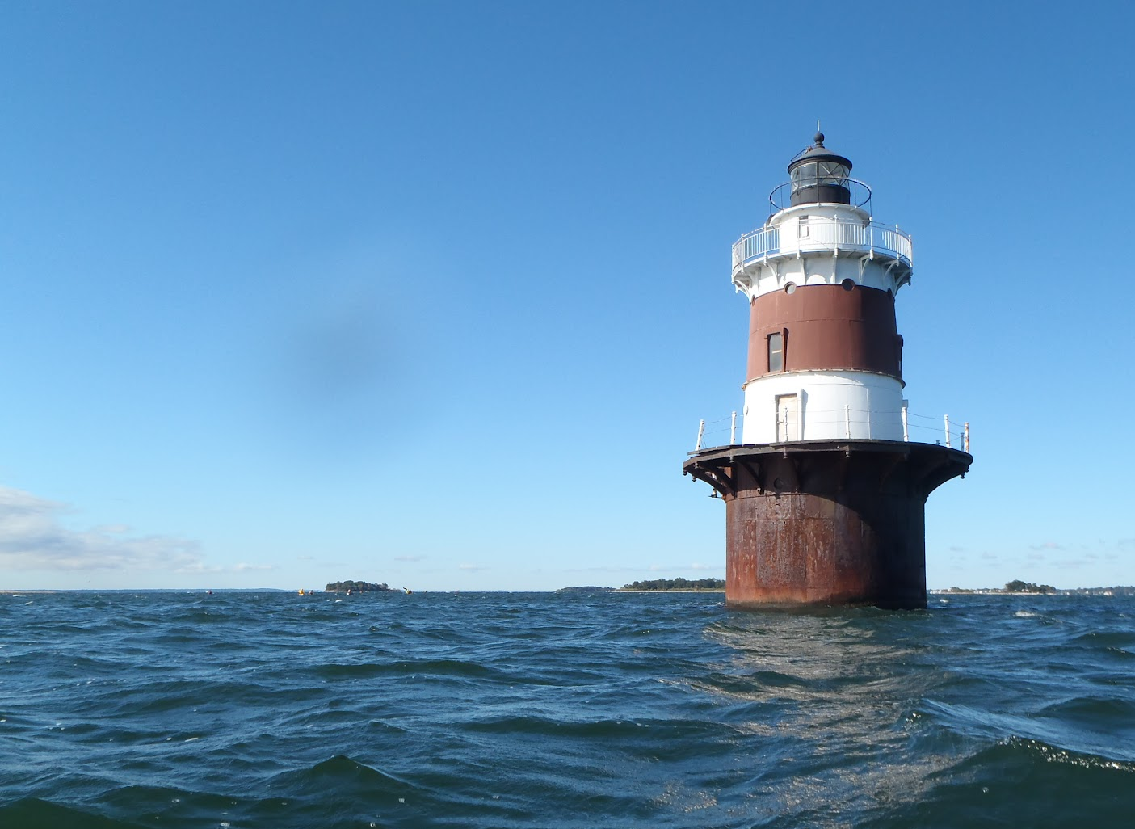

UWS Data Visualization & Feature Sets
Tracy Brown & Martin Hain
Save the Sound
Peter H. Linderoth
Save the Sound, Western LIS Programs
Peter H. Linderoth
Water Quality Program Manager
https://www.flickr.com/

Slide 2

Scope of UWS Data Visualization Project
  Visualize the Unified Water Study Data “Report Card Style” with Grades A-F
  Provide Context for Data = Connect with Issues
  Put Data into Action to Drive Change = Improved Water Quality

Slide 3
Today’s Goals
Discuss the “User Experience” that will provide the most value for the UWS Data Display:
    Who are your target audiences?
    What are your desired outcomes?
    What additional datasets would be useful if paired with UWS data?
    As one of our key data user groups – How do you want to access, view and use the UWS data?

Slide 4
Sound Health Explorer (SHE)
As it exists today

Slide 5
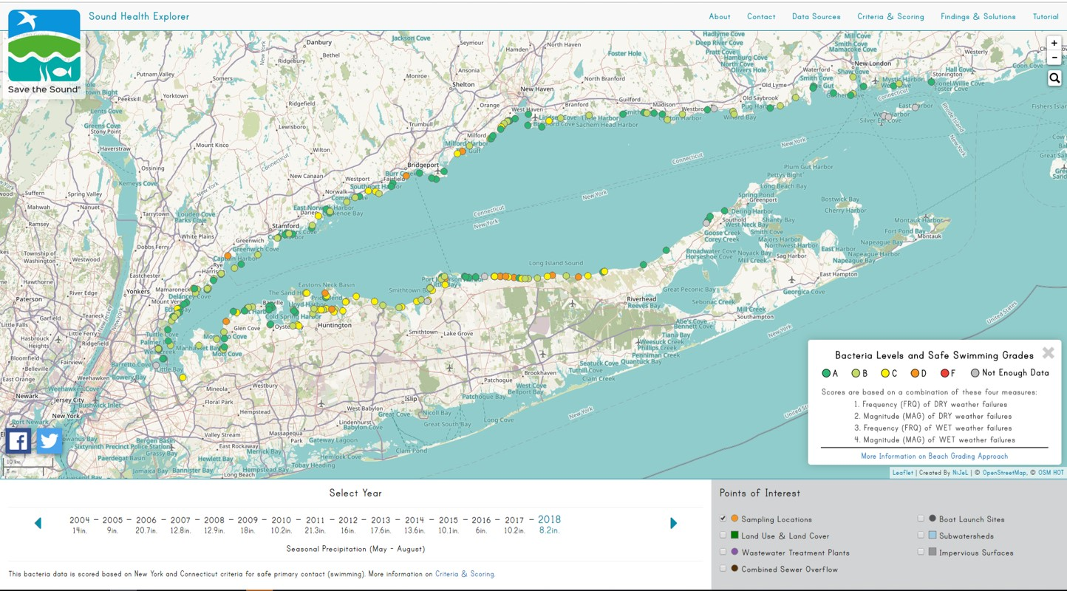
Sound Health Explorer (SHE): Data Visualization
Expansion – Beach data will become 1 channel, 1 story among many

Slide 6
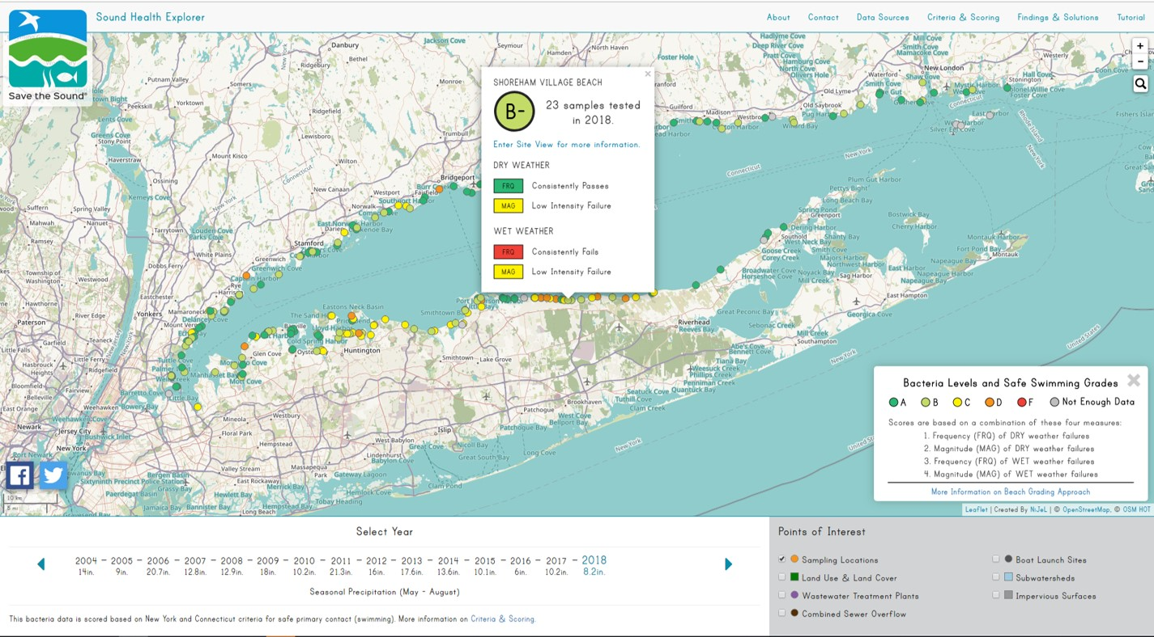
Sound Health Explorer (SHE): Data Visualization
Target Audiences
General public who use beaches
Elected officials of beach towns
Advocates (including STS staff) who can use data to discuss beach water quality, identify problem areas, drive action to clean up our beaches
Notes:
Define target audiences & Examples of Target Audiences

Slide 7
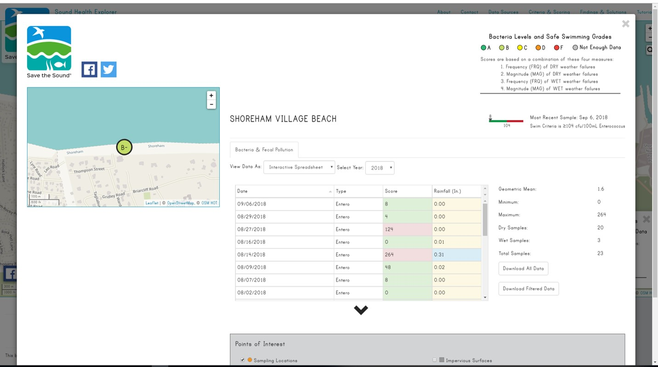
Sound Health Explorer (SHE): Data Visualization
Outcomes Desired
Interested citizens are informed about causes of beach closures and which beaches suffer from intermittent pollution
A good beach grade becomes like a good school system – a point of local pride and of competitive spur
Projects are implemented that address sewage and stormwater infrastructure – water pollution is reduced
Notes:
Define Outcome & Examples of Outcomes

Slide 8
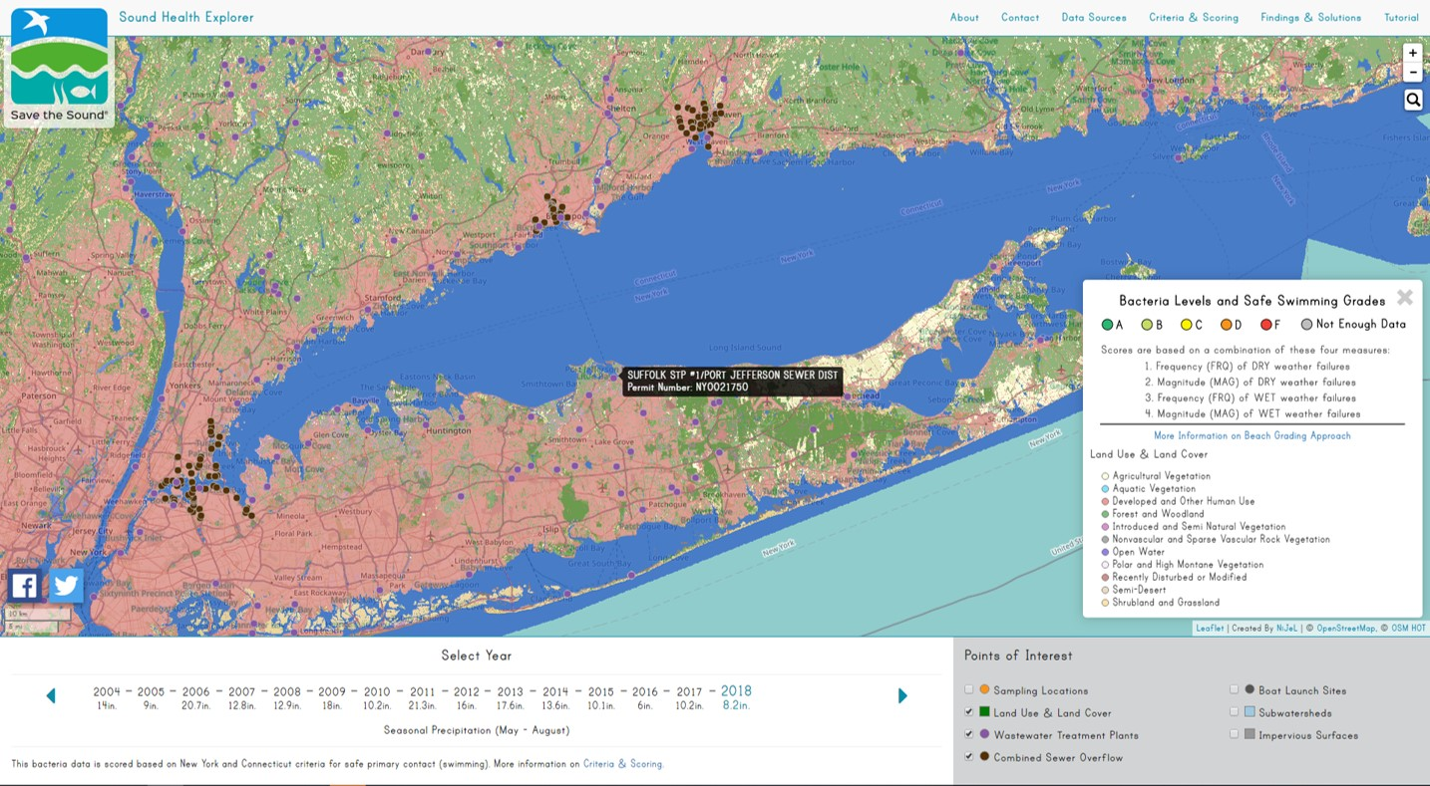
Sound Health Explorer (SHE): Data Visualization
Data Provided
Notes:
Define Additional Data Layers: i.e. Land Use & Land Cover; WWTPs and CSO locations and permits

Slide 9
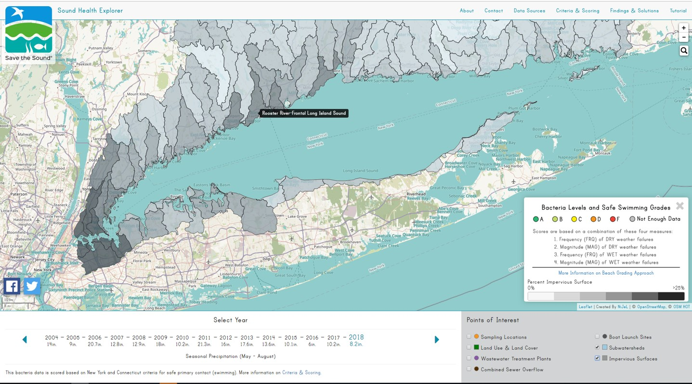
Sound Health Explorer (SHE): Data Visualization
Data Provided
Monitoring data
Other datasets that can inform pollution source tracking
Notes:
Additional Data Layers: i.e. Subwatersheds, Pervious Surface percentage
Data usage on why you should get involved

Slide 10
How do these concepts apply to the UWS data?

Slide 11
UWS Data Visualization Discussion
Who are your Target Audiences?
What Outcomes would you like to achieve?
What Additional Datasets would supplement UWS data?

Slide 12
SHE v.2 Mock-Ups
Very preliminary!

Slide 13
Sound Health Explorer (SHE): Data Visualization
Expansion – Beach data will become 1 channel, 1 story among many

Slide 14
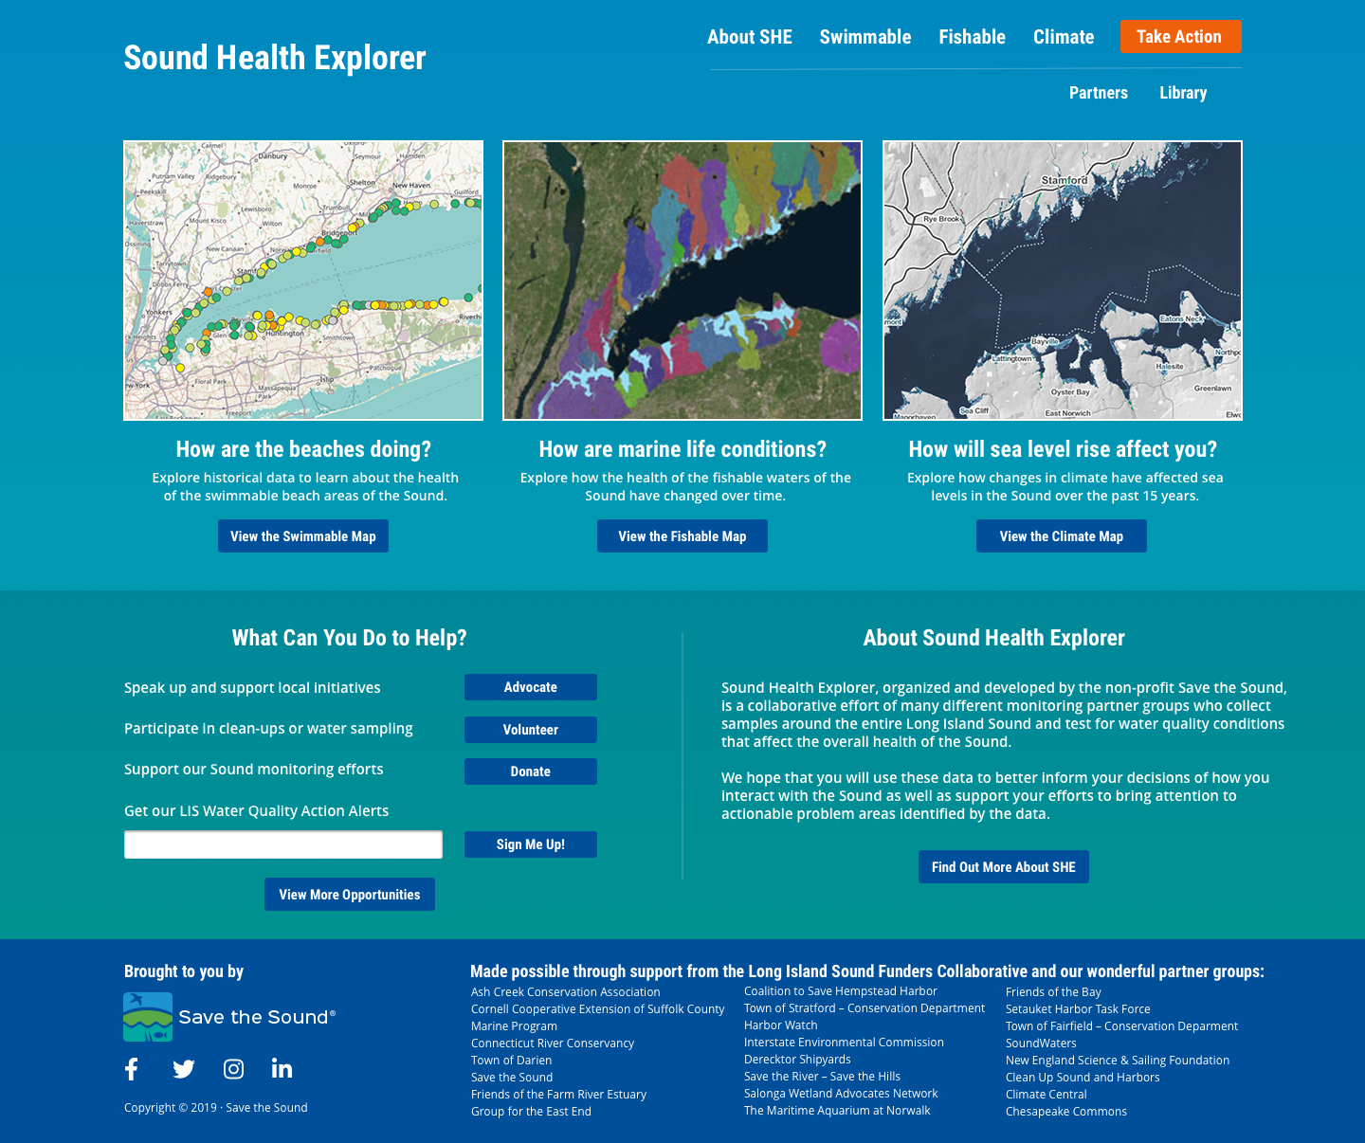
Sound Health Explorer v.2: Landing Page Mock-Up
Notes:
Home mock-up with maps not limited to 3 channels, mention CC

Slide 15
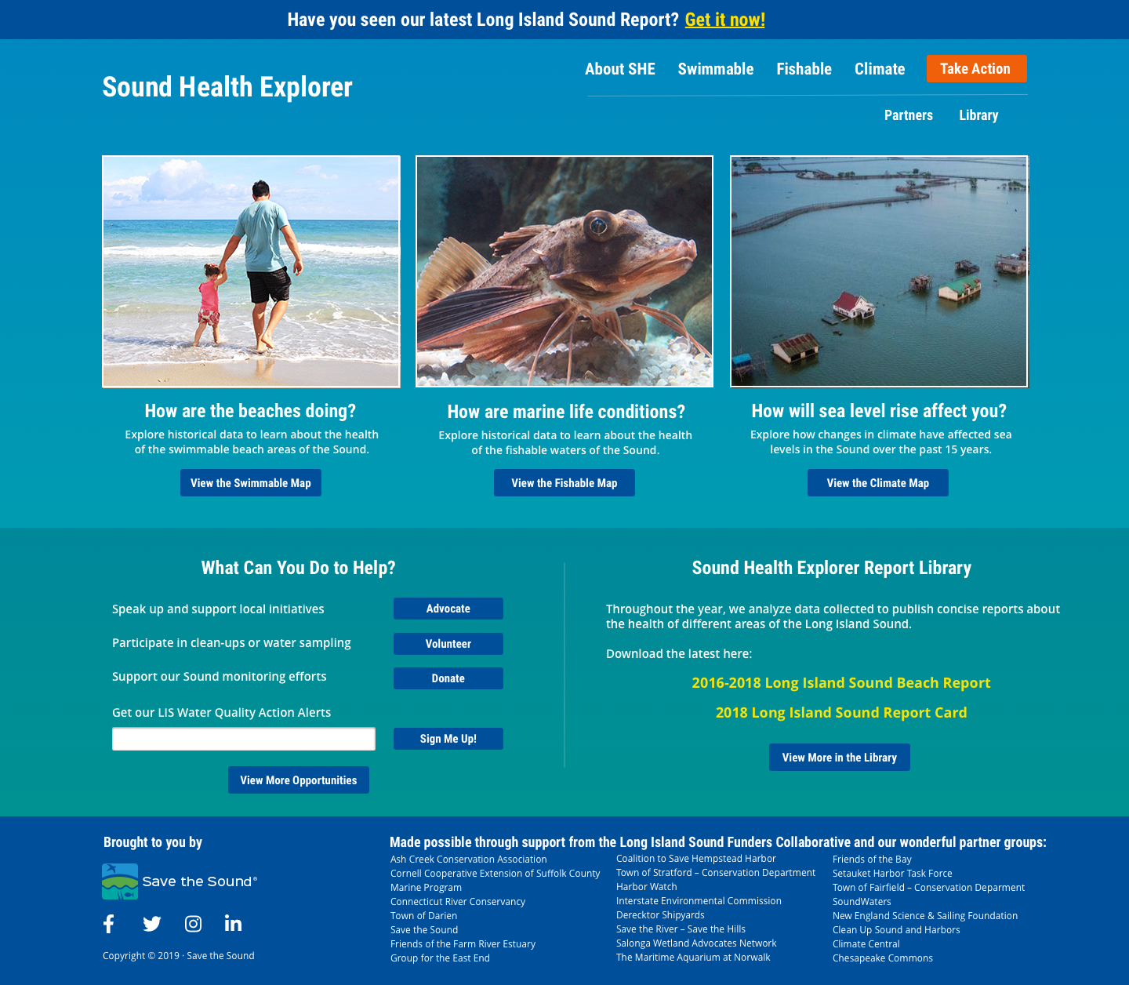
Sound Health Explorer v.2: Landing Page Mock-Up
Notes:
Home mock-up with images
Q& A about Take Action and Reports

Slide 16
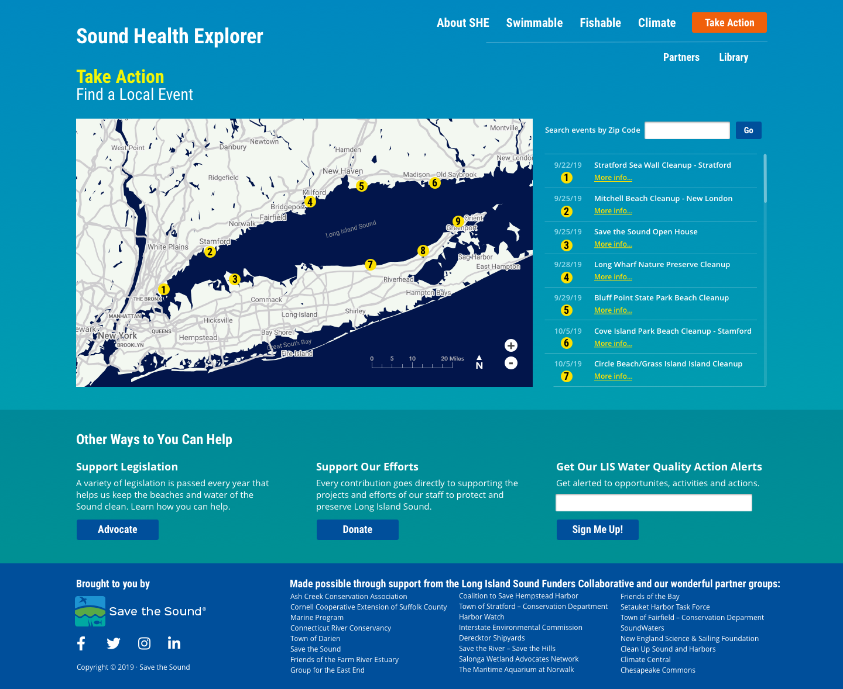
Sound Health Explorer v.2: Take Action Page Mock-Up
Notes:
Take Action mock-up – interest in publishing events?

Slide 17
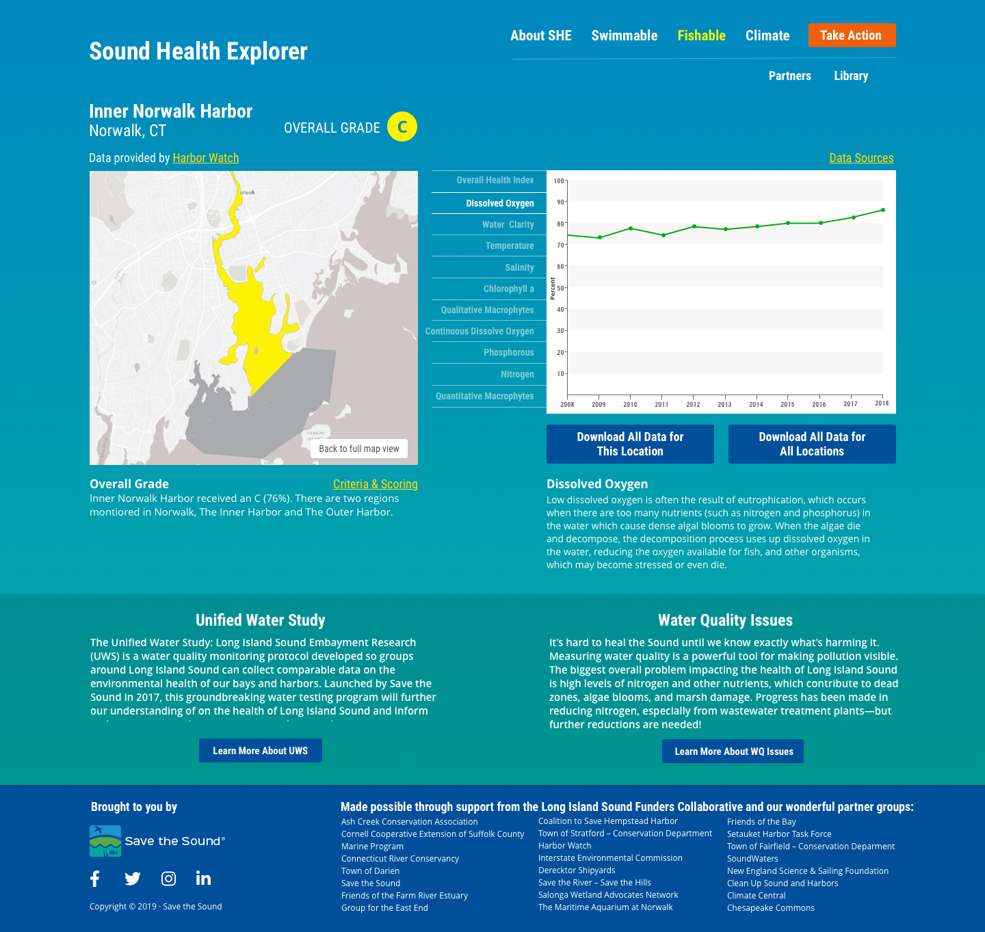

Sound Health Explorer v.2: UWS Site Page Mock-Up
Notes:
UWS monitoring site mock-up

Slide 18
Data Viz Wrap Up

Slide 19
UWS Data Visualization Discussion Wrap-Up
Will this approach support all your goals for UWS data display & usage?
How will you promote the UWS data?
Stay involved! We need your help.
Notes:
Data usage on why you should get involved

Slide 20
Next Steps
UWS Technical Advisory Committee to develop scoring methodology (fall 2019 – spring 2020)
STS and web developer to design and build the expanded SHE website (winter 2020 – spring 2020)
STS to create the 2020 Long Island Sound Report Card, featuring the UWS grades (spring 2020 – fall 2020)
Launch of the UWS data on the expanded SHE website to correspond with the Report Card release (fall 2020)
Notes:
Data usage on why you should get involved

Slide 21
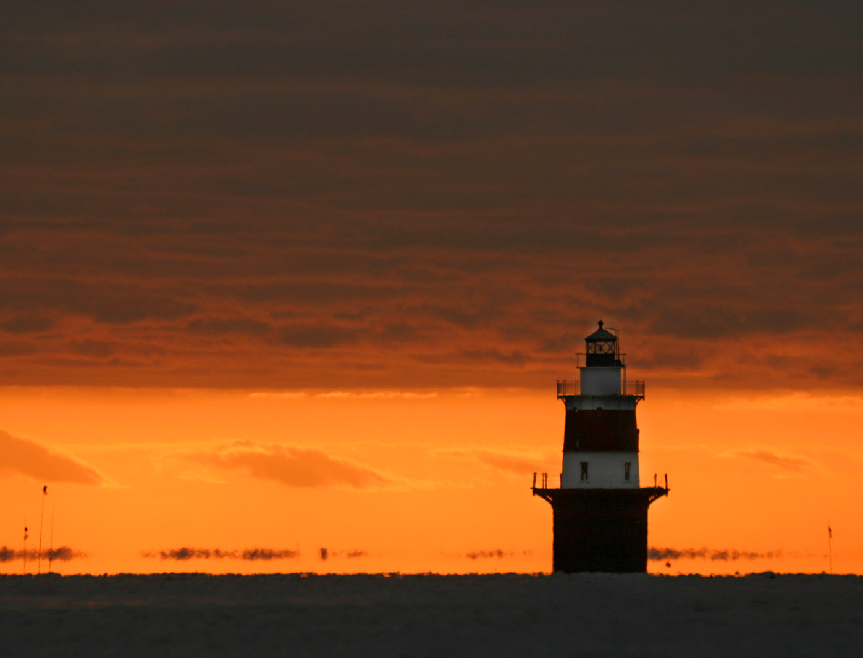
Thank you!
Please contact us
with any follow-up thoughts and suggestions
mhain@savethesound.org
https://www.flickr.com/

